Slide 1


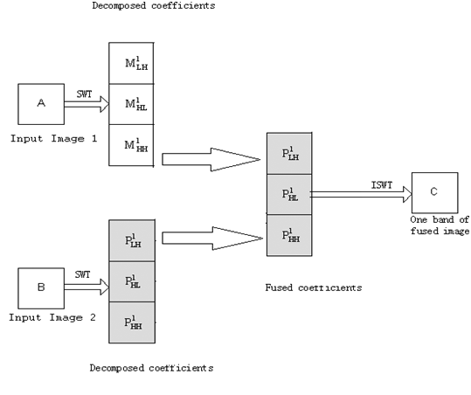
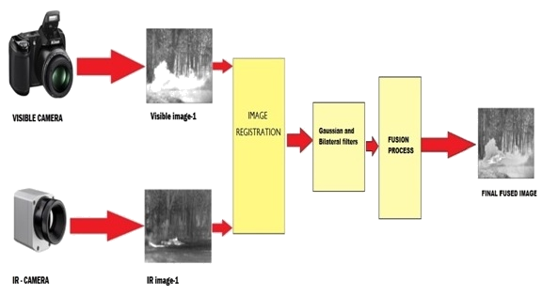
Dayananda Sagar College of Engineering
Department of Computer Science & Engineering
Image Fusion of Infrared(IR) and Visible images using a novel Hybrid MSD approach
Nitin K (1DS13CS067) Shivprasad A (1DS13CS091)
Soumil B (1DS13CS099) Tanish S (1DS13CS110)
Guide: Dr. Shubha Bhat and Mr. Sasidhar Bola
Abstract
Existing system
Results
The goal is to identify the most important information in the source images (Infrared and Visible images) and to transfer, without distortion or loss, this information into a fused image. For better visual perception.
Introduction
The average performance matrix values of proposed method outperform the others in most of the evaluation matrices such as Mutual information, edge association and structural information.
Proposed System
Image fusion is the process of combining relevant information from two or more images into a single image. The resulting image will be more informative than any of the input images.
A novel method to fuse Infrared (IR) and visible images has been proposed based on combining rule for a multi scale decomposition based image fusion.
Conclusion
Experimental results demonstrate that the proposed fusion method is able to provide perceptually better fusion results compared with various other pixel-based multi-scale fusion algorithms.

Slide 2
2 feet
3 feet

